Slide 1
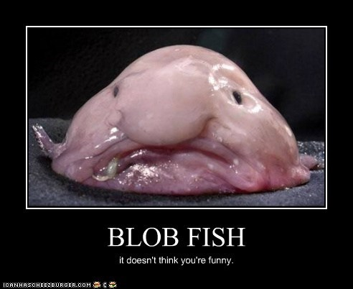
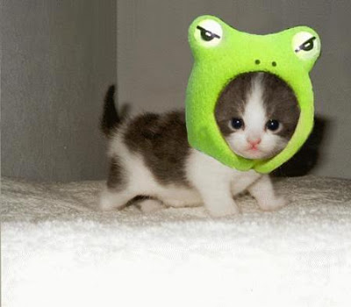
Grab your science folder
Turn in syllabus and safety contract that are due TODAY, now Late.
Have you checked into the website yet?
Have a science folder?
Missed class, what should you do?

Slide 2
Get ready to say Ah Man, AGAIN!!!!
PreAssessment Time
You will quietly and individually do a preassessment regarding topics we will be covering in the next couple of weeks.
We will grade it after everyone is finished.
If you don’t know an answer it is OK to leave it blank on a preassessment, but I prefer you TRY.

Slide 3
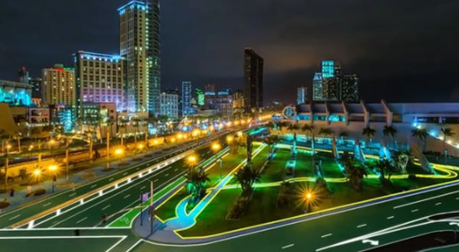
Video Time---You need a piece of scrap paper
Solar FREAKIN' Roadways

Slide 4
Think about it….?
Where did this idea come from? Let’s make it up…..
Let's see what SpongeBob Says...

Slide 5
But 1st let’s watch a video
Inspiration from Forrest

Slide 6
Let’s play….How did they think of that?

Slide 7
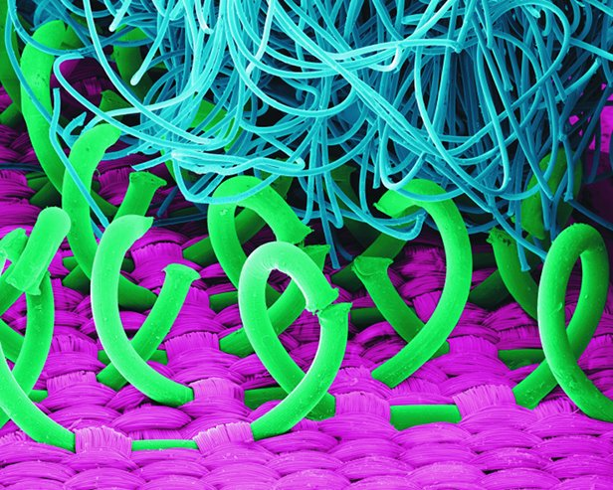
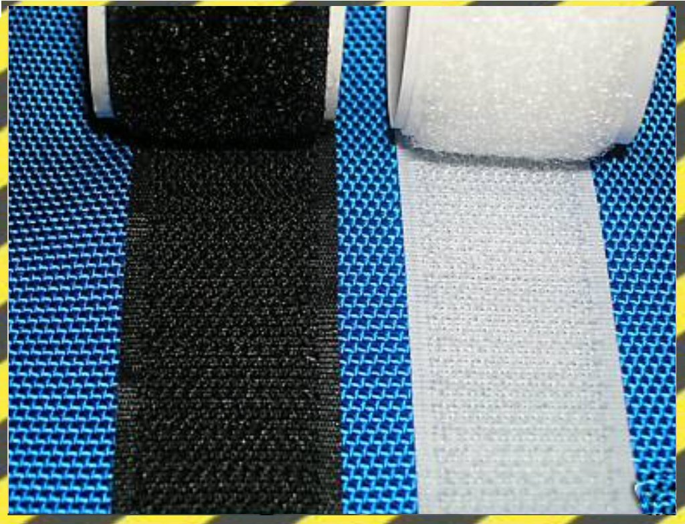
What is it?
In 1948. George de Mestral, a Swiss engineer, returned from a walk and found some cockleburs clinging to his cloth jacket.
When de Mestral loosened them, he examined one under his microscope. The principle was simple. The cocklebur is a maze of thin strands with burrs (or hooks) on the ends that cling to fabrics or animal fur.
By the accident of the cockleburs sticking to his jacket, George de Mestral recognized the potential for a practical new fastener.
It took eight years to experiment, develop, and perfect the invention, which consists of two strips of nylon fabric.
One strip contains thousands of small hooks. The other strip contains small loops.
When the two strips are pressed together, they form a strong bond. It is strong, easily separated, lightweight, durable, and washable, comes in a variety of colors, and won’t jam.

Slide 8
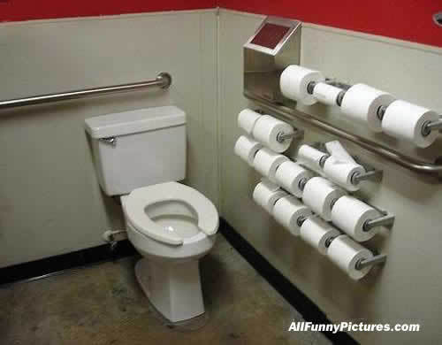
What is it?
Zeth Wheeler patents rolled and perforated wrapping paper in 1871.
By 1874 he had is own business the Rolled Wrapping Paper Company, but the company couldn't turn a profit.
In 1877, Wheller reorganized into the Albany Perforated Wrapping Paper Company and began selling Perforated paper ('The Standard') on a roll.
It sold in plain brown wrappers and fit conveniently into the American bathroom, which at the time was quite small.

Slide 9
Shopping bag
Walter H. Deubner ran a small grocery store in St. Paul, Minnesota, and he was looking for a way to give his business a boost.
By careful observation, he noticed that his customers purchases were limited by what they could conveniently carry.
He set about devising a way to help them buy more purchases at one time. It took him four years to develop the right solution: a prefabricated package, inexpensive, easy to use-and strong enough to carry up to seventy-five pounds worth of groceries.
The package consisted of a paper bag with cord running through it for strength. Deubner named his new product after himself, calling it the "Deubner Shopping Bag," and sold it for five cents. Deubner patented his product and within three years, by 1915, was selling over a million shopping bags a year.

Slide 10
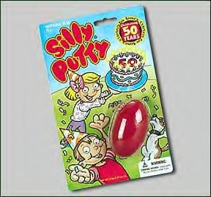
What is it?
During World War II, James Wright working for the General Electric laboratories had produced a synthetic, pliable rubber that was cheap and useful for a lot of small jobs as a caulking and molding medium.
With the war over, a large supply existed, and no one seemed to have any idea what to do with it.
Mr. Hodgson came up with one. He bought a large amount, put it into plastic eggs, and sold it to children
Kids could use it to make spiders and snakes, ware it on their faces at Halloween, and even lift comic-strip pictures right off the pages of the Sunday funnies.

Slide 11
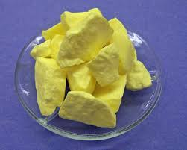
Look at the objects being passed around…
Make as many observations as you can….

Slide 12
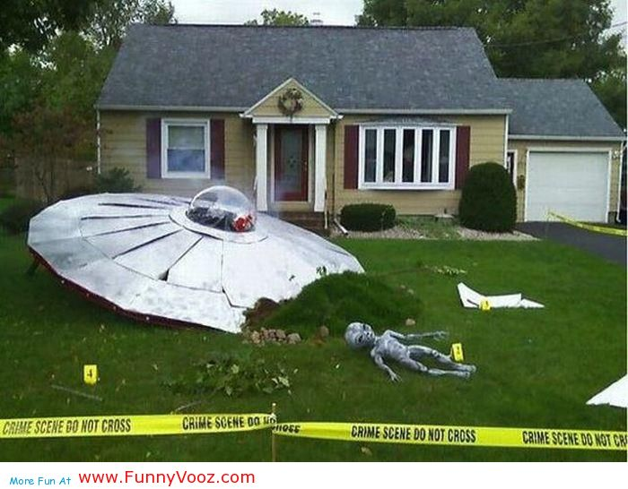
1st thought?
What have we been doing while discussing this pic? Scientifically speaking.

Slide 13
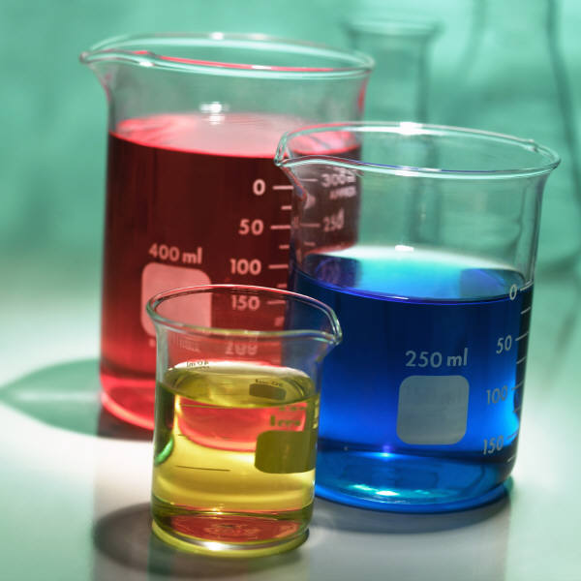
How To Create a Lab Write up

Slide 14
Turn to page 2 of your packet
We will be starting near the middle of the page…

Slide 15
Before you do a Scientific Investigation, you need a Reason…
Sometimes your purpose comes from observations and inferences that you have made.

Slide 16
Important Question
What’s the difference between an OBSERVATION and an INFERNCE?

Slide 17
Observations – There are 2 types
Qualitative observations use your senses to observe the results. (Sight, smell, touch, taste and hear.)
Quantitative observations are made with instruments such as rulers, balances, graduated cylinders, beakers, and thermometers. These results are measurable.

Slide 18
Inferences- are explanations of observations.
It smells that way so it must be a….
It is that color so I assume it is a(n)

Slide 19
Which type of Observation is it?
There are 33 students in this room.
Quantitative-observations made using #’s
The students in this classroom look very well groomed.
Qualitative-any other observations

Slide 20
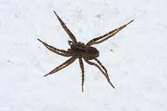

Slide 21
Some things to remember
When making Observations…Leave your bias behind
We all know what happens when you ASSUME….
Assumptions come later when INFERING.

Slide 22
And don’t forget…
ALWAYS RECORD your observations.

Slide 23
Oh….
And you may have to do it again….

Slide 25
Let’s Practice Observations and Inferences

Slide 26
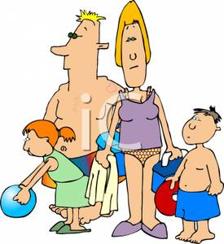

Slide 27
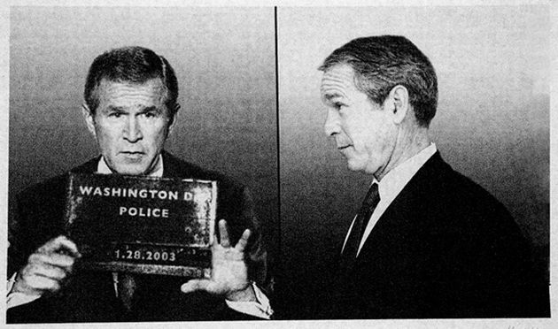
Make OBSERVATIONS…what do you INFER from your observations?

Slide 28
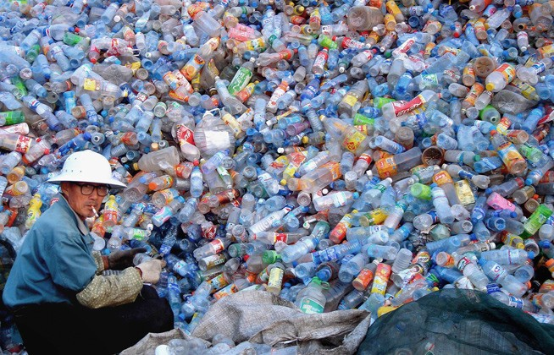
Did you know we throw away 200 billion plastic bottles every year?

Slide 29
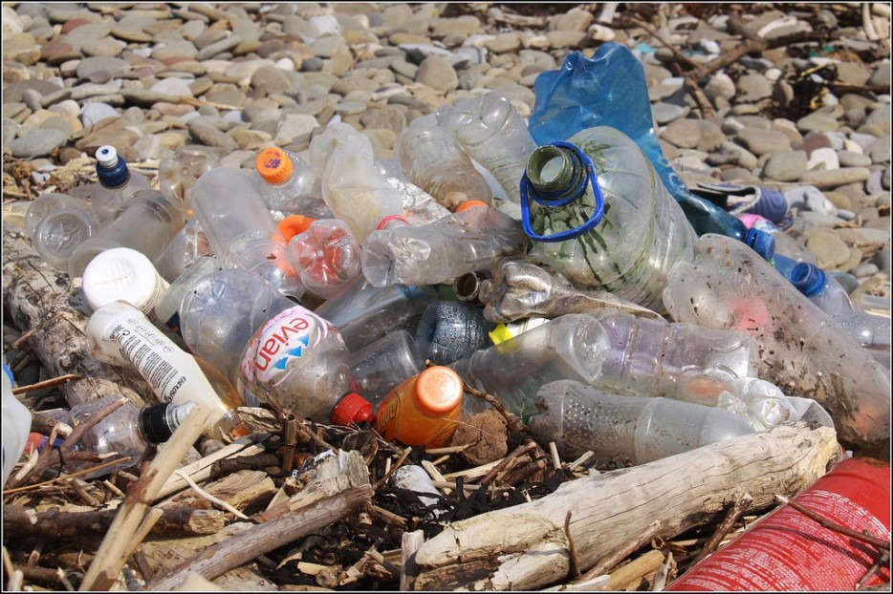
The worst part is, they don’t degrade like other trash. Nearly every piece of plastic ever made still exists somewhere.

Slide 30
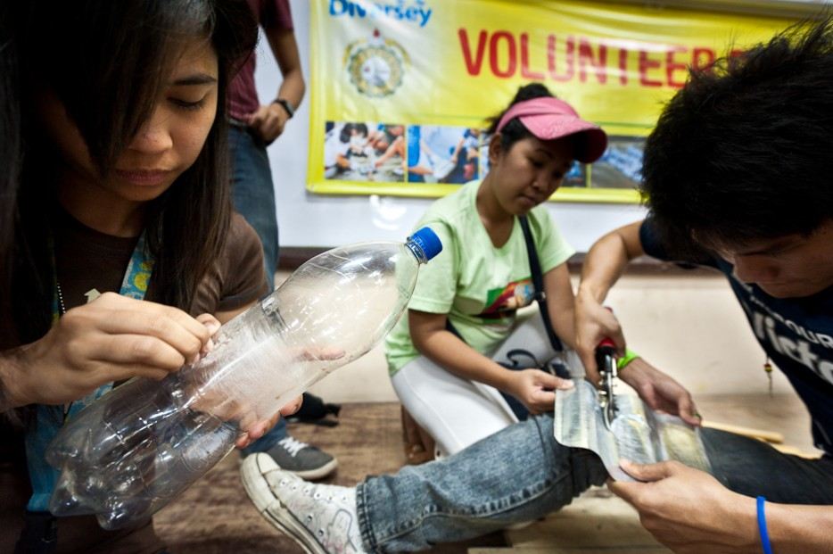
What if we stopped throwing plastic bottles away, and started using them to solve problems instead?

Slide 31
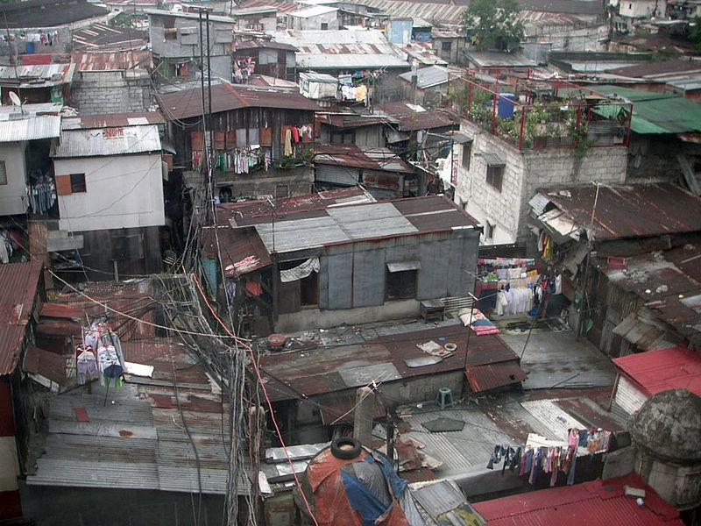
In the Philippines, thousands of people live in shanty towns where houses are built so close to each other, they have no windows or natural light.

Slide 32
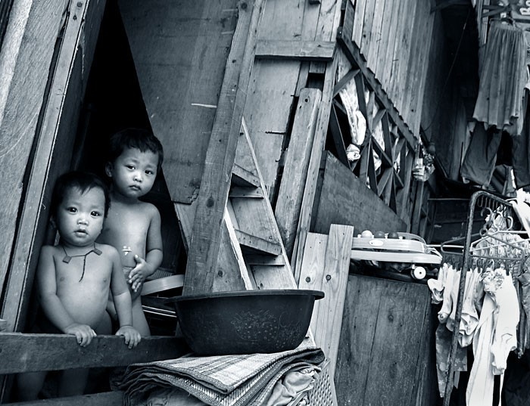
Without electricity, or access to the sun, families must work, do chores, and eat in near darkness.

Slide 33
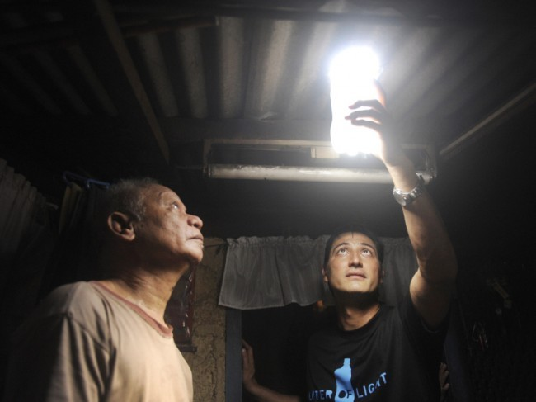
Alfred Moser and a group of MIT students realized that with just a little tweaking, plastic bottles could bring light to struggling Filipinos.

Slide 34
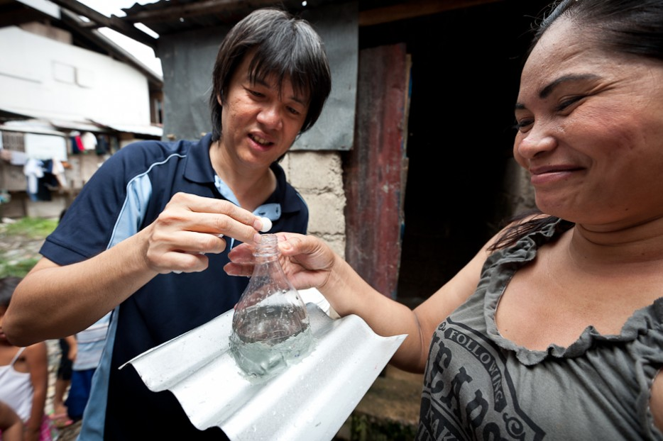
Each bottle is filled with water and a bleach tablet is added. When installed through a hole in the roof, the bleachy water refracts and spreads the sunlight, which illuminates the room beneath just like a light bulb would.

Slide 35
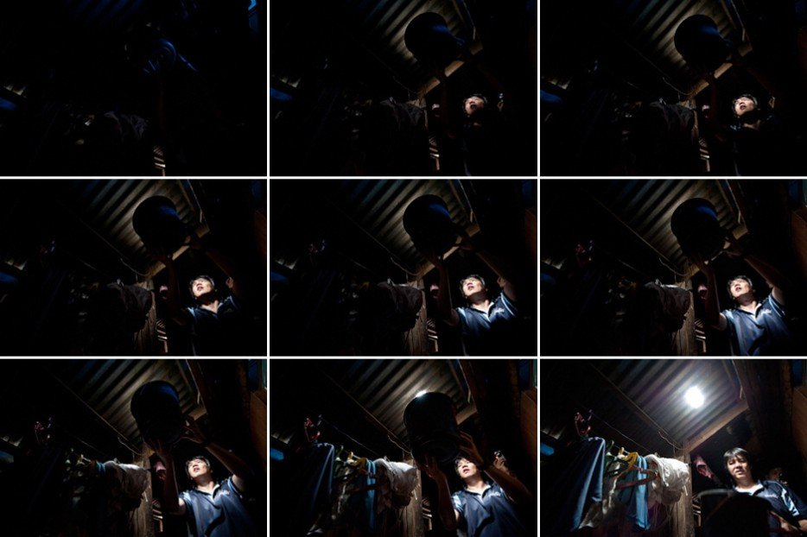
This discovery marked the beginning of the Liter of Light movement.

Slide 36
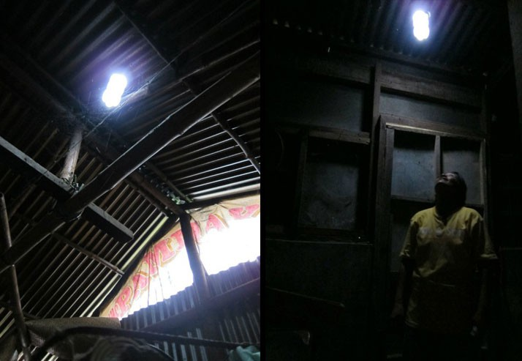
So far, these plastic bottle lights have brightened 28,000 homes and the lives of 70,000 people in Metro Manila alone.

Slide 37
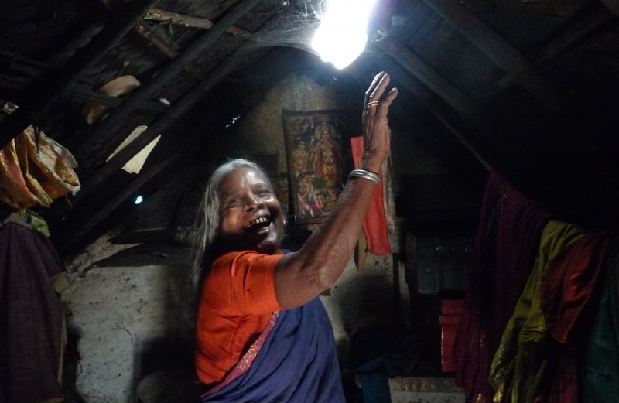
Other people, in India, Indonesia, and even Switzerland, have started using the solar light bulbs as well.

Slide 38
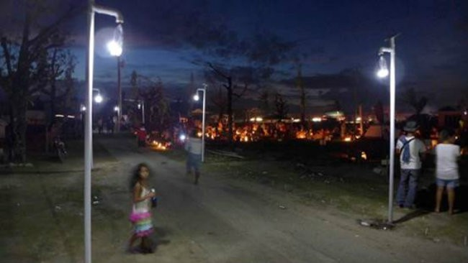
The goal is to install one million of these solar light bulbs around the world by 2015.

Slide 39
Let’s revisit our outside observations from Last Class

Slide 40
Examining the World Around us..
There are some changes….
Let’s edit first
In your own words, write the definitions based on what you already know.
List 4 observations with inferences from yesterday.
DON’T DO THE BACK, yet.
You have 6 minutes……GO

Slide 41
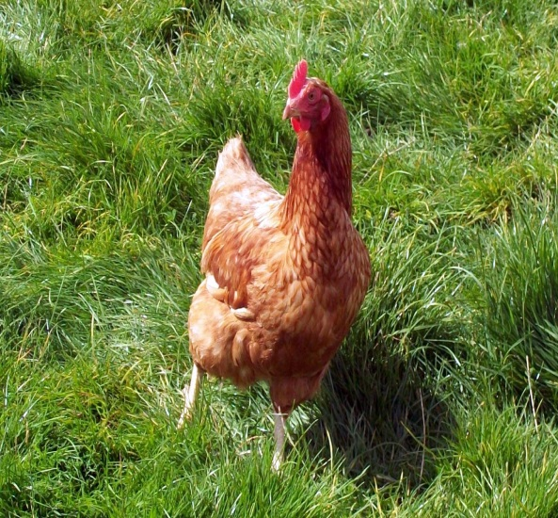
I observe a wild chicken running around my backyard, so I infer that someone dumped their unwanted chicken.
The Environment
The Object

Slide 42
The Environment
The Object

Slide 43
Sometimes our Observations lead to….
Experimental Question/Purpose: This is the question that you are trying to answer through experimentation.
It should not be a yes or no question.
Examples:
Does changing the amount of water used affect the number of seeds produced by a sunflower?

Slide 44
But to have an appropriate question you must be able to identify your…
Variables
Let’s take a pre-quiz

Slide 45
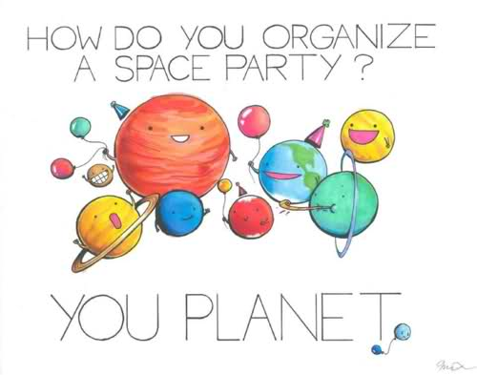
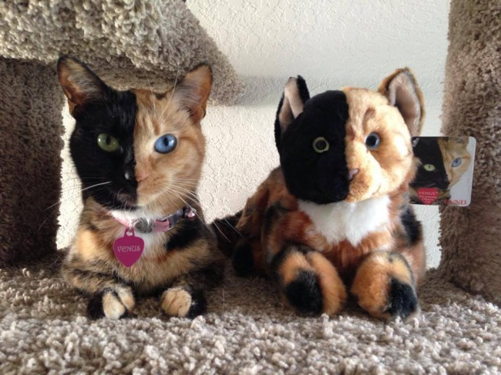
Happy Tuesday!

Slide 46
6th Block Variables Pre-Quiz Results
+0/7- 0 person
+1/7- 1 people
+2/7-3 people
+3/7-3 people
+4/7-3 people
+5/7-5 people
+6/7-5 people
+7/7-10 people

Slide 47
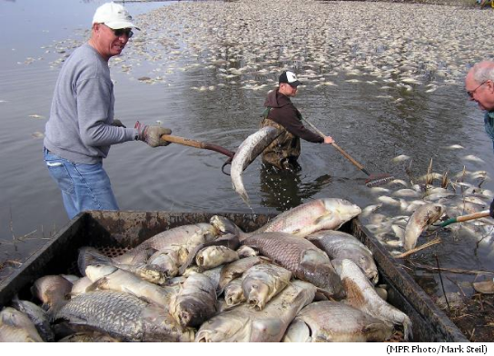
Quick Review

Slide 48
Variables: Variables are factors, conditions, and/or relationships that can change or be changed in an event or system
Why are variables important?
In science you must use variables to experiment, without variables there would be nothing to observe

Slide 49
Let’s see some examples….

Slide 50
Three Kinds of Variables
Independent Variable-also called the manipulated variable
this variable is intentionally changed by the person doing the experiment
This variable will come from the ENVIRONMENT LIST that you made.
Pick one that you want to alter.

Slide 51
Very Important…
There is ONLY ONE independent variable.

Slide 52
Example:
In the “Growth of Maple Tree in Varying Amounts of Sunlight” experiment
-What variable will be intentionally changed by the experimenter?
The amounts of sunlight

Slide 53
Hint:
What am I changing?

Slide 54
2. Dependent Variable- Also called the responding variable
This variable will be effected by what the person decided to do with the independent variable, in other words it “depends” on the independent variable
This variable comes from your list of measurable things about the object.
Pick one that may be effected by the Independent Variable that you choose.

Slide 55
Example:
In the “Growth of Maple Tree in Varying Amounts of Sunlight” experiment
-What variable will respond to the
independent variable?
Growth of the trees

Slide 56
Hint: What is being measured or tested?

Slide 57
3. Control Variable
This is a variable that stays the same for each trial of the experiment
It does not change
This is EVERYTHING else on the ENVIRONMENT list that you made.

Slide 58
Hint:
What stays the same?

Slide 59
Example:
In the “Growth of Maple Tree in Varying Amounts of Sunlight” experiment
-What variable(s) does not change?
Could be, amount and type of water, type of soil, type of tree

Slide 60
Let’s Practice Identifying Variables

Slide 61
Quick Review
We have Observed and Inferred.
We have listed Variables; What 3 HINT ?’s do I use when identifying VARIABLES?
I.V.- What am I changing?
D.V.- What is being measured?
C.V.- What stays the same?
We have written science ?’s
We have written perfect hypothesis

Slide 62
What’s the point Mendenall?
Why are these concepts important to you, the teenage high school student?

Slide 63
Here’s why
Real Life Problems
and not so realistic

Slide 64
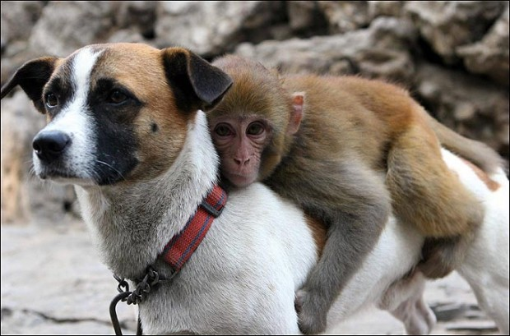
It’s Friday, Yay!
You need to grab
Your folder (always)
A writing utensil
Did you think of any REAL Life circumstances in which you apply the scientific process?

Slide 65
Now I have my Experimental?
What’s next?
It is time to start setting up your formal investigation…
The following will guide you…

Slide 66
Please look at Page 1
Your lab report will be a formal write up about the results of the experiment you have designed or performed.
It will be written in a 12pt. font in Ariel or Times New Roman

Slide 67
It must maintain MLA standards with one inch margins all around.
It must include each of the following sections. Section need to be labeled (do not label title)

Slide 68
The Title
MAKE SURE IT MAKES SENSE TO THE READER.
Needs to include Independent and Dependent Variables.
It will be centered

Slide 69
Title continued
There are no title pages attached to lab handouts.
Examples:
Number of Sunflower Seeds Produced vs. Amount of Water
Amount of Sunflower Seeds Produced When Using Varying Quantities of Water

Slide 70
The Introduction
This section will include the Background, Experimental Question/Purpose, Variables, and Hypothesis
What parts of the Introduction have we already discussed?

Slide 71
Introduction continued..
Background: In this section you will include the scientific principles that relate to your scientific investigation.

Slide 72
For example.
For the following experimental question/purpose you would include information about photosynthesis, growth rates of sunflowers, typical seed counts, etc.
Be sure to cite your sources.

Slide 73
What’s next…
We have already covered the Variable and the Experimental Question.
Please turn to page 3

Slide 74
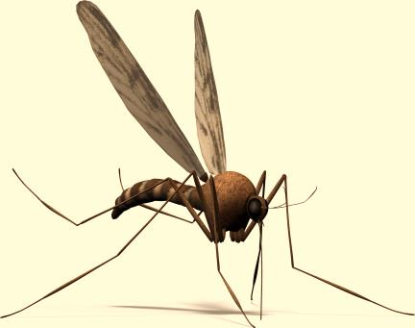
On a white board…
Write a hypothesis for the following situation.
Mrs. Mendenall would like to figure out why Ploopy seems to be sad lately. She plans to release a bunch of mosquitos around the room tonight as a treat for him.
Now set your board aside,
DON’T ERASE IT

Slide 75
The Hypothesis
Hypothesis:
This is a statement predicting the outcome of your experimental question/purpose.
This prediction should be based on your background information.

Slide 76
This statement includes the Independent and Dependent Variables.
It needs to explain how you think the Independent variable will change the dependent variable.

Slide 77
You may use an “if…then…” statement, but it is not necessary.
The hypothesis does not start with “I think” or “I believe”.

Slide 78
Your instructor may omit this section in certain labs.
Example: If varying amounts of water is used while growing sunflowers, then the sunflower that receives the highest quantity of water will produce the most seeds.

Slide 79
In the Margin….
If _________________ then ______________ + prediction.
AND BE SPECIFIC!!!

Slide 80
Example 1
The students are wondering if their attitudes have an effect on the amount of homework they get. They have decided to be positive all class period long on Monday, but on Tuesday they will be negative.

Slide 81
Example 1
The students are wondering if their attitudes have an effect on the amount of homework they get. They have decided be positive all class period long on Monday, but on Tuesday they will have be negative.
What’s your hypothesis?

Slide 82
Example 2
The students want to see if different smells travel at the same speed. They spray a can of hairspray, peppermint air freshener, and insect repellant at the same time. Six friends stand around them in a large circle, five feet from the center of the circle where the three students stood.

Slide 83
Example 3
The students want to see if different smells travel at the same speed. They spray a can of hairspray, peppermint air freshener, and insect repellant at the same time. Six friends stand around them in a large circle, five feet from the center of the circle where the three students stood.
What’s your hypothesis?

Slide 84
Example 3
The students want to know if studying with music has an affect on student test scores. One group of students will study with music in the background, the other group will study in silence.

Slide 85
Example 3
The students want to know if studying with music has an affect on student test scores. One group of students will study with music in the background, the other group will study in silence.
What’s your hypothesis?

Slide 86
Let’s do a Lab!
And practices doing this science stuff…. ☺

Slide 87
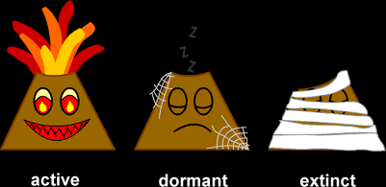
Good Morning
When forming the perfect Hypothesis…..
What steps should you take?
And in for format should it be written?

Slide 88
Let’s Review what we have discussed thus far..
Title
Introduction
Background
Experimental ?/Purpose
Variables
Hypothesis

Slide 89
Safety Precautions
This section should highlight the safety concerns that are specific to the lab being performed.

Slide 90
Every lab must have a section of safety.
If nothing else, there is no horseplay in the lab.

Slide 91
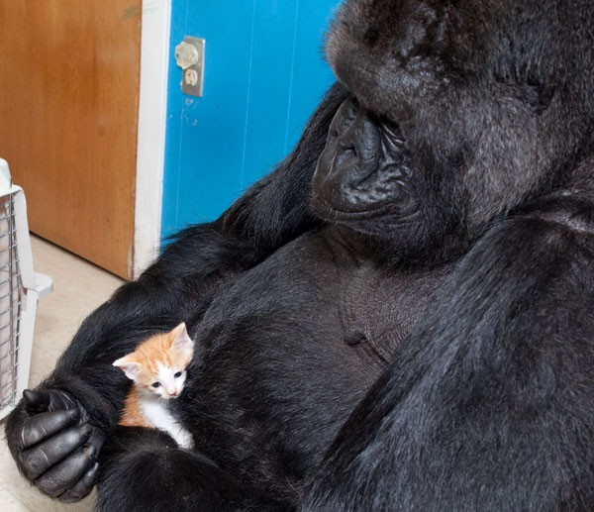
Howdy Class
Grab your folders and notes…

Slide 92
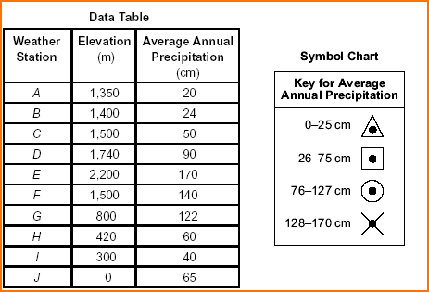
Is this a data table or graph?
Is it labeled correctly, anything missing?
Should there be any additions or edits made?
Identify the variables.

Slide 93
Materials
This is a list of all equipment, chemicals, and materials needed for the lab.
Designate size and quantities Example: 500 mL beaker
All materials in this section should be used in the procedure section.

Slide 94
Procedure
This is detailed explanation of what you will do in the experiment.
It is step by step.
It must include a labeled drawing of the setup.

Slide 95
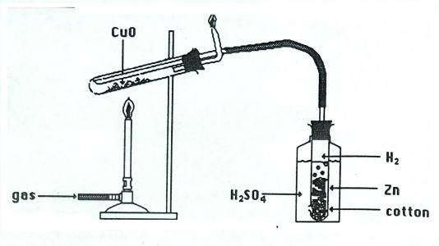

Slide 96
It must be written in such a way that an outside person could pick up your procedure and complete the experiment exactly as you have.
Note: When applicable you will also include a section that defines your experimental group from your control group (not to be confused with your control variables).

Slide 97
Data Table(s)
The recorded data must include both quantitative data and qualitative data.
You must prepare a data table with the independent variable on the left (labeling the rows), and dependent variables to the right (labeling the columns).

Slide 98
 | # of seeds after 90 days
8 oz of water Sunflower A
16 oz of water Sunflower B
24 oz of water Sunflower C
Don’t forget to title your data table
Data Table:
Number of Seeds produced by Sunflowers watered with different amount of water
D.V.
Labeling
the columns
I.V. Labeling
the rows

Slide 99
Be sure to include units, a title, and the most precise measurements possible
Remember to always conduct a minimum of three trials

Slide 100
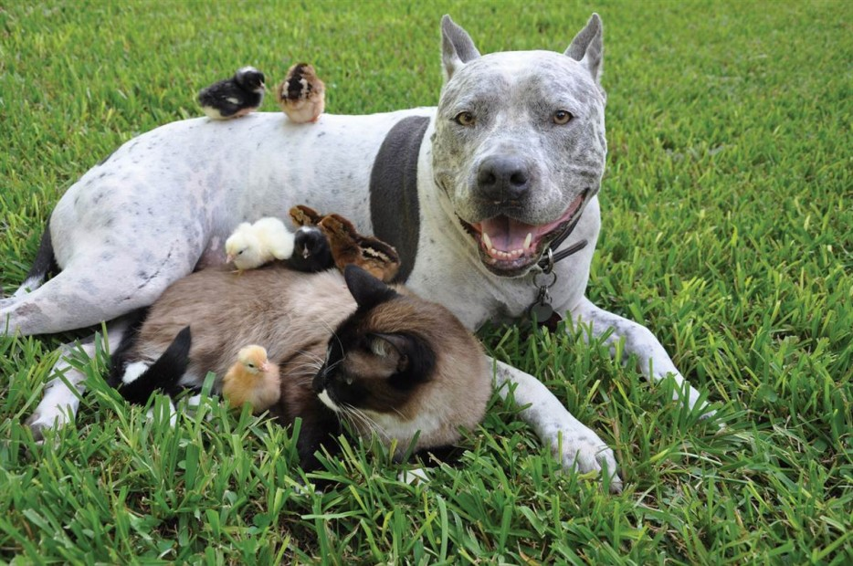
It’s Thursday, Yay
1st thing today you will need.
Your folder (always)
A highlighter
A writing utensil

Slide 101
Is this a data table or graph?
Is it labeled correctly, anything missing?
Should there be any additions or edits made?
Identify the variables.

Slide 102
We will now practice creating Data Tables
Grab a white board

Slide 104
A seed was planted. As the plant grew, it was measured over a six day period.
Day one: 0 cm, Day two: 2 cm,
Day three: 5cm, Day four: 7cm,
Day five: 8cm, Day six: 10cm

Slide 105
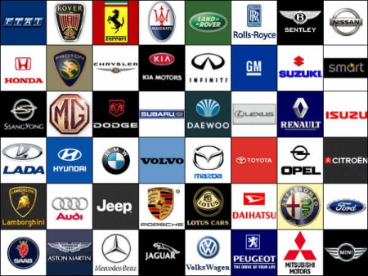
The students were instructed to look for these types of cars in the teachers’ parking lot and record the number of each.
Ford: 12, Chevy: 16, Dodge: 9, Buick: 9, Volvo: 1, Honda: 2,
Toyota: 1

Slide 106
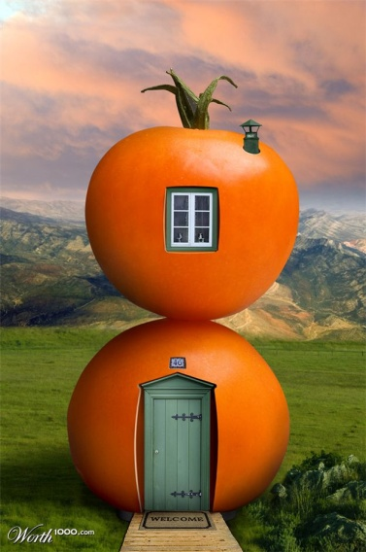
Tomato plants were grown at various temperatures. The number of tomatoes that grew on each plant was counted.
TRIAL 1
8⁰ C: 4 tomatoes, 12⁰ C: 10 tomatoes
16⁰ C: 14 tomatoes, 18⁰ C: 22 tomatoes
22⁰ C: 24 tomatoes, 24⁰ C: 16 tomatoes
TRIAL 2
8⁰ C: 5 tomatoes, 12⁰ C: 13 tomatoes
16⁰ C: 12 tomatoes, 18⁰ C: 19 tomatoes
22⁰ C: 26 tomatoes, 24⁰ C: 11 tomatoes

Slide 107
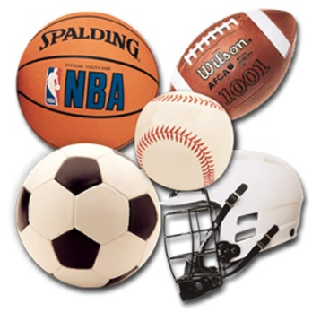
Different types of balls were bounced from a table top. The height of each bounce was measured
Trial 1
The Golf ball bounced 54 cm, the baseball bounced 9cm, the tennis ball bounced 48 cm, ping pong ball 21 cm, and the Styrofoam ball bounced 3 cm
Trial 2
The Golf ball bounced 48 cm, the baseball bounced 6 cm, the tennis ball bounced 51 cm, ping pong ball 25 cm, and the Styrofoam ball bounced 5 cm

Slide 108
After you have your data….what do you do with it?

Slide 109
Data Analysis
The data analysis consists of two parts: showing your work for all mathematical computations performed and a visual representation of your data in the form of a graph if appropriate.

Slide 110
The analysis should include patterns and trends and/or statistics (discussion of the trends will take place in the conclusion section).

Slide 111
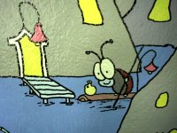
And FINALLY…

Slide 112
Conclusion:
Your conclusion consists of three parts.
Part 1
The first part is devoted to answering the question: Do you accept or reject your hypothesis and why?

Slide 113
You need to use your evidence (data) to explain why you accept or reject your hypothesis.
*Note: If you reject your hypothesis that does not mean you did something wrong.

Slide 114
Part 2
The second part should discuss possible errors and/or limitations in the experiment. Simply stating “Time management” and “human error” does not suffice, you must be specific.

Slide 115
Example: If you used too small a sample size (If you are trying to see if the students at Central like the school lunch you can’t ask 3 friends and make an accurate conclusion, the sample of people asked should be much larger)

Slide 116
Example: Equipment error (Poor calibration of equipment, wrong equipment, Equipment not precise enough)

Slide 117
The second part should also include improvements that will be made if the experiment were repeated. Improvements need to be realistic and achievable.

Slide 118
Part 3
The third part is a discussion of where the investigation will go next. . Often an experiment will raise more science questions, you should tell the reader what question you will try to answer next and how you will try to answer it.

Slide 119
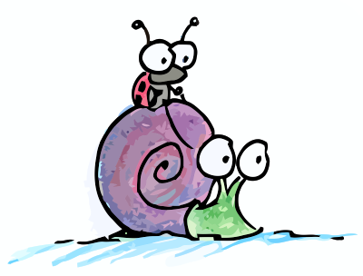
The End
YAY!

